Slide 1
Mojaloop Portfolio Planning
January 2021

Slide 2
Goals for 2021: Where do we want to go?
North Star focus for 2021
(1) Traction on the ground
(2) Community sustainability
Live hubs, with connected DFSPs, running real money rails is the ultimate goal – without this we can’t start on a financial inclusion impact metrics

Slide 3
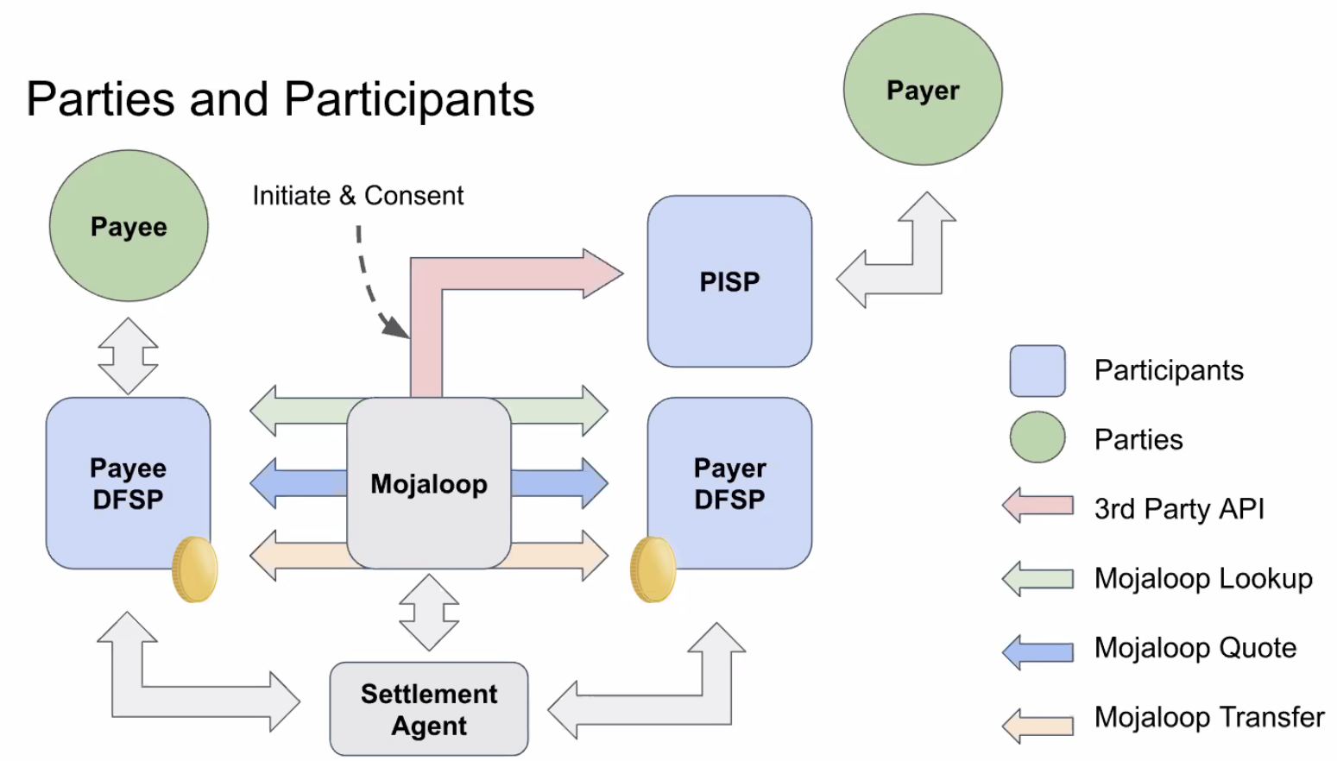
What is the measurement of success for a Traction North Star?
Proposed targets for 2021:
3 Closed User Group Pilots
that are the focus for the open source functional roadmap discussions
1 real money commercially launched implementation starting to scale
Bonus: 3 Training/Venture/Hackathon/Techsprint organisations
independently able to support Mojaloop awareness building in a more scaled way
Defining “Adopters”
In formal (national) space driven by RFPs:
the trio that leads to a hub running when working nationally: Scheme, Hub Operator running the payment system, DFSP Participants
Private sector market-led opportunistic:
May start more informally with alignment around a painpoint between DFSPs of different types
DFSPs = neobanks + those holding emoney funds for merchants – lets widen our definition for open loop!
Or can start with a hub operator who is willing to do the work to get DFSPs connected, live and interacting effectively
Defining a CUG Pilot
A consortium of 3 DFSPs minimum solving for a use-case that is enabled by our blueprints
A scoped engagement using Mojaloop assets, that has determined its own funding model
It could involve a regulator for bonus points
The consortium should have:
Clarity on who will run the hub operationally for that consortium & how the digital asset will move from open source to a CUG operational deployment.
Clarity on how settlement will be done
How can Mojaloop Foundation support you?
Notes:
We must start measuring ourselves through the lens of outcomes/progress towards an ultimate goal, and not only on amount of software checked-in

Slide 4
Readiness for Growth
There are 8 elements to our product offering, because we recognise simply putting software on github is not a solution that creates last mile impact & will not create our ultimate vision of financial inclusion via deployments.
Our Value | Readiness
Our design blueprints & our API interfaces | Not centralised blueprint content & hence not sufficiently complete to call it a blueprint for less technical audience Knowledge scattered across the community, hard to see how to piece it together, some old demos are now archived (only historical knowledge of use case potential, or knowledge in TIPs/ Mowali/ MIFOS/ Myanmar or other adopters of what they’re doing with it)
Our open source cost-effective ready-for-cloud or local deploy, scalable-when-you’re-ready hub software can get you to real money live systems in an accelerated manner | lack of reference UX widely available using the APIs removes the ability to get started quickly We have looked at the cost at scale quite a bit in project work, but needs to be finalized/finished not so much information on the cost at little scale determined, or the cost to get started with the basics all in play. How does the hub software need to change to be compatible to relevant existing plug-ins? Are we thinking about that? .
Our thought leadership | We have published some scheme rule design material from Glenbrook - we don’t measure or advertise or refine it yet. How might we increase our relevance here, or partnerships with others here, as a means to grow awareness/adoption ? Have we got potential to be a voice in the regulation-as-code / rules-as-code movement that helps us with adoption? We haven’t published our design principles We don’t publish our FRMS material (but also don’t have a way for good actors to know it exists.) We don’t have example UX at OSS level around best practice biz processes at hub.
Our ability to be a demonstrator kit for change in RFP approach from traditional routes, due to our open source starting point | Not established at all centrally under the Mojaloop brand. All interested parties in our blueprints must work with a technology company in the community, which makes it hard for conversations to be sufficiently neutral earlier in the pre-sales cycle today. We need to work (via a partner program) at having good answers to the vendor lock-in challenge – to be able to truly differentiate
Our ability to be a neutral POC/Sandbox in your own cloud tenant very simply | The interface is API centric, so experimentation only possible if you are a technology player Its possible to imagine a set of vendors in the community that could create a standardised offer to potential adopters, to get this delivered to a basic level, affordably However it does still very much require a technology team, so if a consortium didn’t have their own technologists they would need a procurement process
Our tools that help consortiums to get started quickly | We have put a lot of work into this in last year (Connection Manager, Payment Manager, TTK, plus tools at MIFOS We should have standardised offers from the community about how they might support closed user group pilot consortiums. We could do more to simplify the products we have in this space and talk about them the right way. How might we start to talk about a compatible set of plug-in solutions more?
Our marketplace of supply slide companies | We don’t yet talk about this as a marketplace / partner program – a level of supply/demand thinking to kickstart it. We have our training program
Our continuing collaborative open R&D | Well underway, however its not yet organic growth (requires funded development) - lack of “skin in the game” players in the community?

Slide 5
2021 will be the year of…
Traction risk
Removing Friction to get started
Traction risk
Cost Reduction
Reputational Risk
Understanding and Resolving Gaps through the eyes of Adopters to enhance traction
Confidence in our claim of Trustworthy, Quality & Credible
“Ready for Production”
Traction risk
Reputational Risk

Slide 6
As you decide on Friday…
Our Business Goals unpack to work that the developer community should focus on through the lens of traction risk and reputational risk.
Not all of the necessary work to be resourced is writing code.
In prioritising community activity - must test ourselves to ensure we can answer:
Will this increase adopter traction? Can you be specific about what adopter and how?
Will this remove reputational risk of the hub failing to deliver for our target adopter?
The Mojaloop Adoption Funnel
Awareness
Interest
Mojaloop Branded Environment
Consideration (Mojaloop Environment)
Intent (Own Environment)
“Pilot in a Box” Standard Offer ?
Deployment (CUG Pilot Environment)
At national level may be non-cloud & custom
Commercial Launch (Scaled Production)

Slide 7
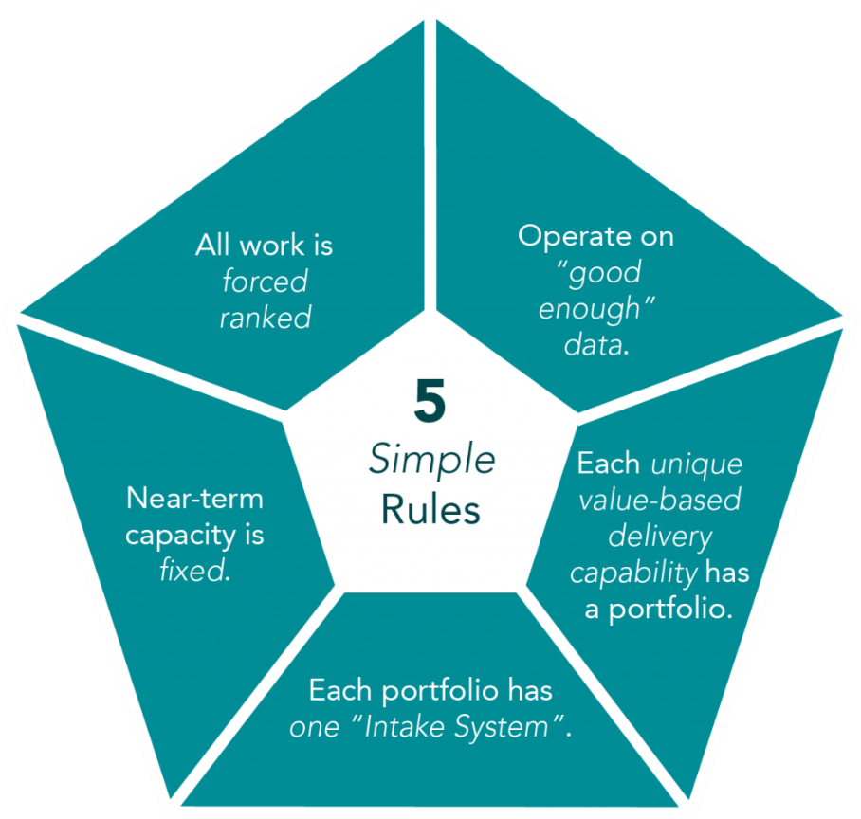
Agile Portfolio Management is an Enabler of Adaptability
We need to be able to spring into action in the face of opportunity
We need:
predictable delivery capacity
rapid risk reduction
fast feedback from adopters & GTM teams
ease in changing direction
Ensure that your conversations & decisions on what to build are:
Business-value focused
Limit work in progress
Shorter releases, smaller deliverables
Ability to reprioritize when needed
Notes:
Agile Portfolio Management is an Enabler of Organizational Adaptability
Organizational adaptability is a business’ ability to spring into action in the face of opportunity. This may be evading catastrophe or expanding new markets. In this historical moment in time, organizational adaptability is top of mind for everyone. Bringing agility into portfolio management, governance, budgeting and finance is a critical enabler of organizational adaptability and business agility. Watch our five-part video series and the recording from our recent webinar and live guest panel to learn more!
All work is forced ranked.
Artificially ranked work is a sign of too many dependencies. The portfolio may have been sliced artificially.
Organizations that make everything the highest priority cannot articulate real priorities. In the world of infinite demand with constrained capacity, who knows what the true strategy is?
Operate on “good enough” data.
No one has detailed data for all portfolio items at the stage decisions need to be made.
External demand for artificial precision indicates planning is uncoordinated.
Certain levels of detail in one area do not necessitate expensive-to-obtain detail in other areas. (This is how hours-based estimates in annual planning became common in traditional organizations.)
Near-term capacity is fixed.
We cannot hire and bring knowledge workers up to speed fast enough to influence the outcomes of Portfolio Management for three to six months at least.
While there may be exceptions to this rule, they are far more rare than funding managers want to acknowledge.
Each unique value-based delivery capability has a portfolio.
An isolated component team can not deliver realizable value without other contributions.
Subdividing a portfolio further reduces transparency, which undermines the purpose of connecting work to strategy.
Each portfolio has one “Intake System”.
Strategic decisions in a portfolio should have full visibility into the entire scope of work required to innovate, build, release, evolve, support and sunset technology. (I have never met a portfolio manager who hasn’t “robbed Peter to pay Paul.” When we have over-divided a portfolio, this creates huge churn and long tails where a piece of work is postponed when everyone else thought it was to be completed in parallel.)

Slide 8
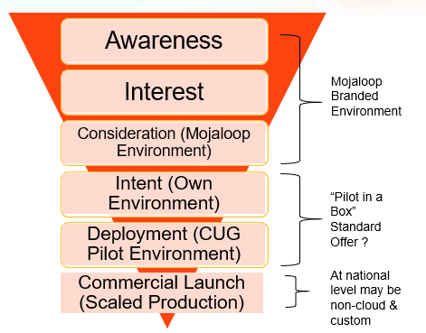
In your breakout group:
Do we understand the problem(s) to be solved ?
In prioritising what to work on - test ourselves to ensure we can answer:
Will this increase adopter traction? Can you be specific about what adopter and how? Or where in the adopter funnel you are adding business value?
Will this remove reputational risk of the hub failing to deliver for our target adopter?
Can we articulate a hypothesis: “if we do this work, we believe …… will happen”
What are we worried about that might make it hard to solve that problem
Do we understand the amount of resource available between now and next community event to work on that problem?
How are we thinking about measuring success and finished? (or that the choice was not the correct way to move the needle and we need to do something differently? )
What can product council actively indicate on an adopter-facing roadmap is “coming soon”?
Notes:
Do we understand the problem(s) to be solved ?
( some groups will already have clarity, particularly where product council have gone deep already; the technical roadmap might need to start here). Ensure shared understanding, before going to solutions. Where there are lots of problems – do we understand the high value problems to focus on first?
The tech stream in particular would benefit from not solutionising too early, and keeping a focus on the north star objectives & things that are barriers to us achieving that (through lens of trustworthy, credible, quality). Because everything is important.
Can we articulate a hypothesis: “if we do this work, we believe …… will happen” - > from an outcome perspective if possible (recognising that many outcomes are empowering GTM & Sales conversations, bar Mowali activity). Nothing is guaranteed with hypothesis language, but helps us keep outcome focus.
What are we worried about that might make it hard to solve that problem - > by unpacking this we understand better how we might not reach our North Star. What seem like the biggest things we need to solve?
Do we understand the amount of resource available between now and next community event?
What problem are we going to be able to FINISH something on within 3 months
How can we “rock break” so that we are able to be opportunistic within these themes on what is scoped next quarter – should a large opportunity come from GTM teams in the field that needs particular energy?
How are we thinking about measuring success and finished? (or that the choice was not the correct way to move the needle and we need to do something differently? )
Could think about this through any of these lenses:
What is the perfect story you’d love to tell at the next community meeting? Or the Q2 community meeting?
How will the effort get deployed either to our foundation sandbox or to a real customer for feedback?
What can product council actively indicate on a customer/adopter-facing roadmap is “coming soon”?
PROMISE LESS! WHEN FINISHED EASY TO START MORE!

Slide 9
Unpacking that to short-term Q1 action…

Slide 10
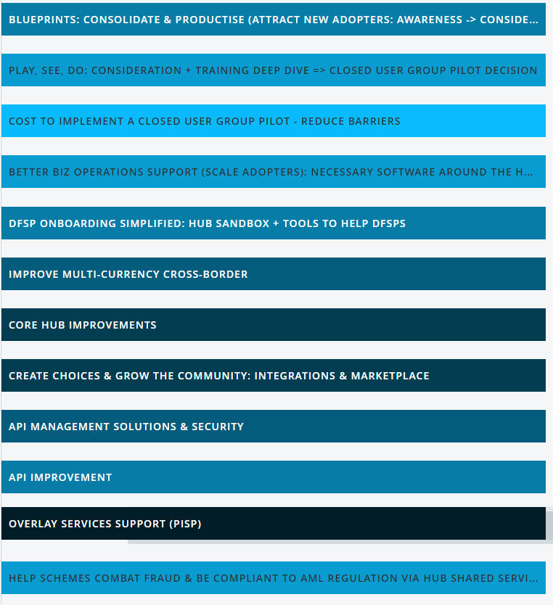
Consolidate & Productise what we have
Consolidate what is “ready” today & simply supported & simply demonstrable to decision makers: “show don’t tell”.
(2) Cost Reduction Baseline:
“pilot in a box” – how do we get everything simply deployed to the cloud for a p2p closed user group pilot, cost effectively at low TPS, that might accelerate our got to market
(3) Better Business Process Support:
linked to pilot in a box & onboarding consolidation – impossible without some better UX – which is also what Mowali want
(4) Technical Roadmap Clarity:
Various workstreams need some fundamental architecture decisions & problem statements/outcomes focus in order to build a viable 2021 roadmap that achieves the 2021 goals
https://eu-rm.roadmunk.com/publish/c6cc73ccfe668b948c583c9f0f0e1e6880930745
https://miro.com/app/board/o9J_lZaY9mU=/
Notes:
Onboarding team should choose which workstream conversation would fit their thinking best to consolidate on what we have. Could be (1), (2) or (3)

Slide 11
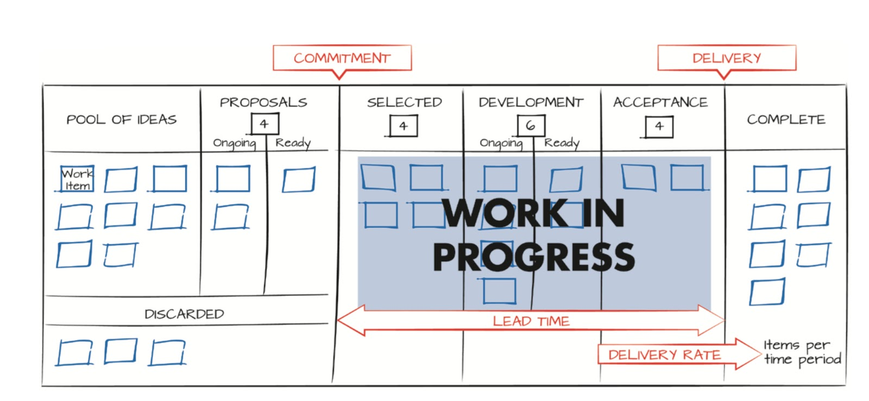
The ultimate goal…
https://eu-rm.roadmunk.com/publish/629be69c3a28c2f78f90b4aa2ccf1247599d8fab

Slide 12
Pillar 1: “Consolidate and Productise”
Feature Baseline & UAT the hub itself as a solution that a scheme/consortium can choose
Mojaloop Portal & Product Documentation + Training Program content – “Be more Stripe”
Better regulator/scheme/consoritum decision maker product content on the web (via the Mojaloop portal too)– what is Mojaloop etc linked to feature baselining – again the tech writer is critical support potentially
Better demos of use cases - > showcase attached to the portal sandbox hub fspiop and pisp api
Better demos of hub in action - > showcase UX attached to portal sandbox hub operations api
Better DFSP content – marketplace of onboarding tools & written content around using it – get started guides
better DFSP & PISP ecosystem developer content - at API level – what lewis has started & tech writer will be critical in – for hacks
better Hub Operator content – running the hub, best practice biz process etc
Better hub operator vendor content – technical internals explained simply
THE ASKS:
Priority: uat & feature baseline
If resourced:
Portal gets underway (kim, lewis, technical writer)
We have a good dfsp population in the sandbox (lewis, ed)
with marketing …. mvp set of explainer videos
mvp set of end to end use cases
If modusbox v1.0 is open sourced: get the ux we have for the portal today accessible at the centre and running
Ensure training program coherently growing alongside!

Slide 13
Work to date
Demo Working Group
Specifying the demos they feel will move the needle to help explain Mojaloop, with end to use cases demos and ux processes around the hub itself
Product Hub Sandbox Environment
Helping to develop a branded running hub sandbox that will include videos, simpler documentation and support demos and hackathons
Ask: increase member support (designers, technical content writers, dynamic explainer presentations/videos, demos of “ready” functionality for non-technical audience to experience, resource to build demo experiences ) to accelerate this

Slide 14
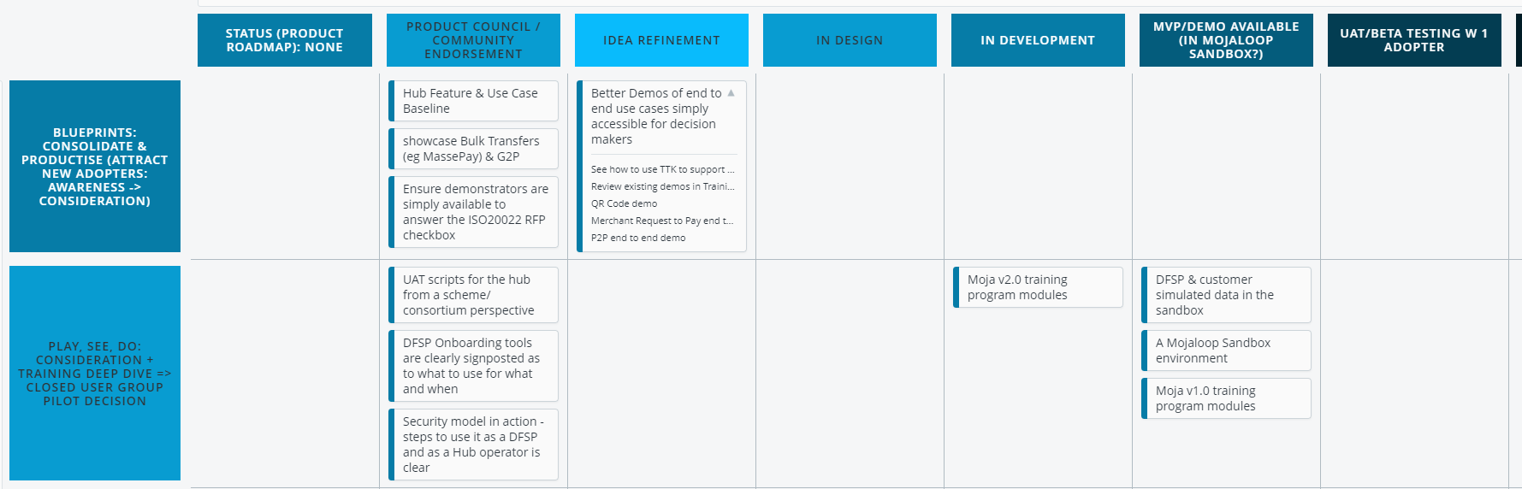
Pillar 1 Roadmap

Slide 15
Pillar 2: “Better Business Process Support”
THE ASKS:
Know our best practice hub processes as a resource for any adopter
DFSP Onboarding
Employee management – hub and DSFP access
Liquidity position updates
Settlement
Configuration – net debit cap, interchange
Get Mowali scaled with better hub (multi-currency settlement)
Get UNCDF able to scale with better hub (single currency settlement)
Get a domain specific useful set of APIs that would allow our community to grow custom *safe* hub operator solutions
Ensure we are capturing an audit trail of every employee action on a website (with role based access thinking) that will feed into an FRMS solution effectively for good business controls & compliance checks.
Support better demos of a more complete hub operator solution (workstream above can't move forward)
Support pilot in a box needs for something out of the box
We know we need to start marketplace thinking - can we connect Sybrin's commercial stuff asap?

Slide 16
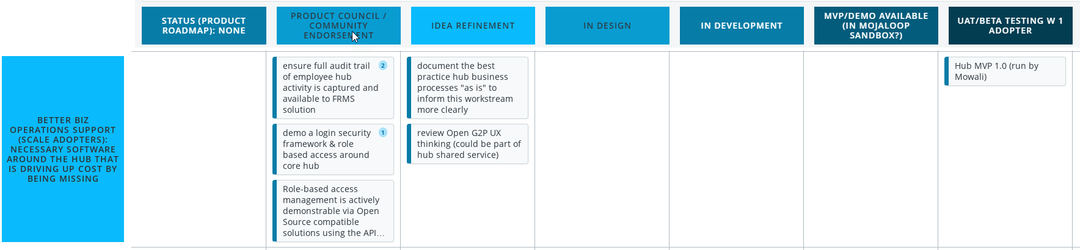
Pillar 2 Roadmap
Mowali insights
UNCDF insights
Product Council Market Requirements work
+
Business Operations Framework Proposal
Sybrin – demo of existing commercially available tools

Slide 17
Pillar 3: “Cost Reduction / Baseline”
How might we make it simpler to go from “yes” to “Closed User Group Pilot”, knowing cost and risk are big barriers today.
Recognising it takes more than technology to get live - > what is the project standardised checklist?
This includes onboarding tool improvements we think are priority at this point
THE ASKS:
What does it cosdt today & why can be clearly articulated, similar to other DPG groups as a standard offer
Group decides right get started approach
Onboarding team should consolidate here also where they believe more improvement adds more business value through consolidation of efforts
Notes:
• PRIORITY (HOEPFULLY RESOURCED)
• WARREN PITCHES THEIR THOUGHTS ON GETTING THIS SIMPLIFIED &
• KIM CONNECTS THIS TO THE COST REDUCTION/PERFORMANCE WORK SHE’S ALREADY DONE
• CONNECT THIS TO LEWIS/LA TO GET A BLANK ENVIRONMENT POPULATED WITH A HELPFUL TEST POPULATION AND SOME DEMOS GET STARTED – WHAT IS INVOLVED
• GET A CHECKLIST OF WHAT OTHER ACTIVITIES NEED TO HAPPEN FOR A SCHEME TO GET STARTED (NOT AUTOMATED)
• MAKE A PLAN FROM THERE
• IF RESOURCED….. ED / SAM/ GSMA –
• BASELINE – AS IS TODAY: THE PROCESS FOR A DFSP TO GET ONBOARDED VIA THE VARIOUS TOOLS ON OFFER
• DESIGN WORK: WORK ON PROPOSING CLARITY FOR ONBOARDING TOOLS MARKETPLACE THAT CAN COME BACK TO LA/KIM
• IF RESOURCED…. WE HAVE A GOOD DFSP POPULATION IN THE SANDBOX (LEWIS, ED)
• IF RESOURCED…. A SCHEME GETS THE DEVELOPER PORTAL DOCUMENTATION CONTETN AND GUIDS ALSO ASO PART OF THEIR DEPLOY.

Slide 18
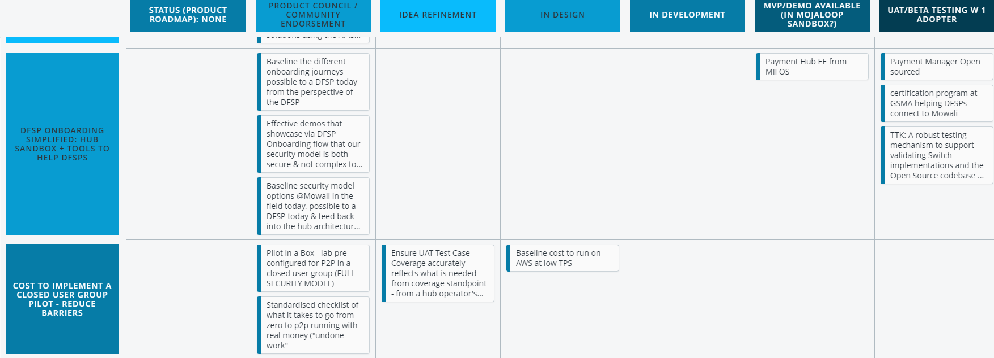
Pillar 3 Roadmap
Existing DFSP Tools Consolidation
Crosslake work on AWS Cost reduction to date
Modusbox Open Sourcing Announcements this week

Slide 19
Pillar 4: “Core Hub is Trustworthy, Quality, Credible”
THE ASKS:
Adopt FXP into the Mojaloop Opensource & improve multi-currency settlement features to allow Mowali to scale
We need a coherent prioritised COMMUNITY-ALIGNED roadmap that delivers on queries from existing adopter, but where we stop starting and start finishing, by focusing and collaborating on outcomes that support traction on the ground based on the 2021 GTM pipeline:
Mowali - a big ask is sorting out the issues linked to multi-currency support & robustness around cascaded timeouts & delivery acknowledgement. (Plus many of the asks covered in work above in other workstreams - onboarding, better biz process support…)
We need to know that the Rwanda blueprint is achievable (or a.n. other nationally scaled ask)
We need to ensure we can achieve 3 closed user group pilots running in parallel on the same common core and pushing towards scale - anything architecturally that could cause us to stumble in achieving year end?
Technical Roadmap Clarity:
Various workstreams need some fundamental architecture decisions & problem statements/outcomes focus in order to build a viable 2021 roadmap that achieves the 2021 goals
Notes:
To name a few:
FXP native support
Notifications have delivery receipt audit trail (callbacks etc)
Telescopic timeouts
Cross Currency native support
FRMS solution compatibility
1000 TPS
Use of Tigerbeetle in the core ledger
Settlement done well (including when there are multiple currencies)
Marketplace thinking (FRMS, Onboarding tools, Business Operations tools, etc)
More flexible APIs (to enable things like transaction splitting).
Simpler categorisation of errors
A decoupling of messaging format from native API (in support of ISO20022, easier DFSP onboarding, and interoperability with other switches more simply))
A locked-in security model based on a look at field reality. (noting the GSMA conversation of what's happening in the real world & Karim's comments that getting central bank to buy "internet open" is unlikely - can we outline clear choices + what is mandatory )

Slide 20
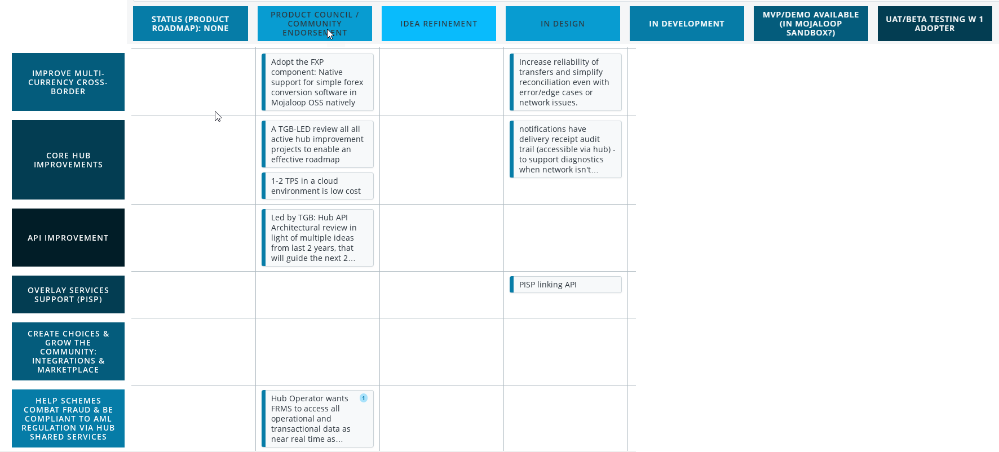
Pillar 4 Roadmap
https://eu-rm.roadmunk.com/publish/c6cc73ccfe668b948c583c9f0f0e1e6880930745
https://miro.com/app/board/o9J_lZaY9mU=/
Full washing list here!:
https://eu-rm.roadmunk.com/publish/c6cc73ccfe668b948c583c9f0f0e1e6880930745

